Slide 1
NTE 1010
Introduction to Finance for Engineers
Spring 2020
Week 3
Analysing & Interpreting
Financial Statements
Ratio Analysis
Vertical & Horizontal Analysis

Slide 2
Ratio Analysis

Slide 3
NTE 1010 – Introduction to Finance for Engineers
Financial Ratios
  Financial ratios provide a quick and relatively simple means of
  assessing the financial health of a business.
  A ratio simply relates one figure appearing in the financial statements
  to some other figure appearing there.
  Ratios can be very helpful when comparing the financial health of different businesses. Nevertheless, differences in scale of operations need to be taken into acount
  in such comparisons.
  Though ratios are not difficult to calculate, they can be difficult to interpret and
  so it is important to appreciate that they are really only the starting point for further analysis.
  Ratios help to highlight the financial strengths and weaknesses of a business,
  but they cannot, by themselves, explain why certain strengths and weaknesses exit,
  or why certain changes have occurred.
  Only a detailed investigation will reveal these underlying reasons.
  There is no generally accepted list of ratios that can be applied to the financial statements,
  nor is there a standard method of calculating many ratios.

Slide 4
NTE 1010 – Introduction to Finance for Engineers
Financial Ratios
Classifications
    Profitability
      businesses exist with the primary purpose of creating wealth for their owners
    Efficiency
      also known as Activity Ratios
    Liquidity
      it is vital to the survival of a business for there to be sufficient liquid resources available to meet maturing obligations
    Financial leverage
      highlight the extent to which the business uses loan finance
    Investment
      Return on Investment, etc

Slide 5
NTE 1010 – Introduction to Finance for Engineers
Financial Ratios
Comparison
  Merely calculating a ratio will not tell us very much
  about the position of performance of a business.
  It is only when we compare the ratio with some ″benchmark″
  that the information can be interpreted and evaluated.
    Past periods
        By comparing the ratio calculated with the same ratio, but for a previous period, it is possible to detect whether there has been an improvement or deterioration in performance. Nevertheless, when comparing the performance of a single business over time, operating inefficiencies may not be clearly exposed.
    Similar businesses
        In a competitive environment, a business must consider its performance in relation to that of other businesses operating in the same industry.
    Planned performance
        Ratios may be compared with the targets that management developed before the start of the period under review.

Slide 6
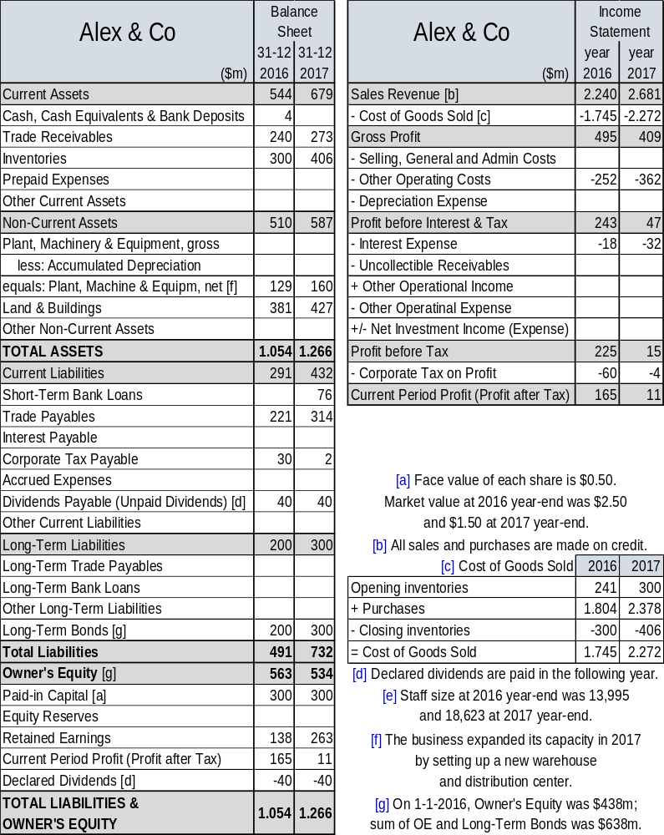
NTE 1010 – Introduction to Finance for Engineers
Financial Ratios
& Financial Statement Analysis

Slide 7
Profitability

Slide 8
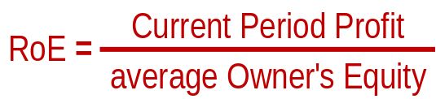
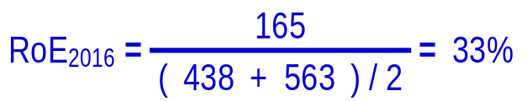
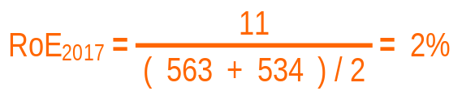
NTE 1010 – Introduction to Finance for Engineers
Financial Ratios – Profitability
Return on Equity (RoE)
  Compares the amount of profit for the period available to the owners, with the owners’ average stake in the business during that same period.
  In general, businesses seek to generate
  as high a value as possible for this ratio,
  provided that it is not achieved
  at the expense of potential future returns
  by, for example, taking on more risky activities.
  The RoE ratio is widely used by businesses when establishing targets for profitability.
  These targets are sometimes made public
  by companies shares of which are traded
  in stock exchanges.

Slide 9
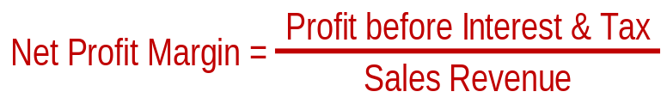
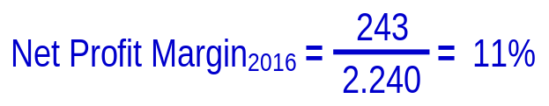
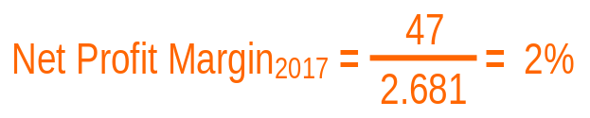
NTE 1010 – Introduction to Finance for Engineers
Financial Ratios – Profitability
Net Profit Margin
  Relates Profit before Interest & Tax for the period
  to the Sales Revenue during that period.
  This is often regarded as the most appropriate measure of operational performance,
  when used as a basis of comparison,
  because differences arising from the way
  in which the business is financed
  will not influence the measure.
  This ratio can vary considerably between types of business. For example, supermarkets thend to operate on low margins. Jewellers, on the other hand, tend to have high net profit margins.

Slide 10
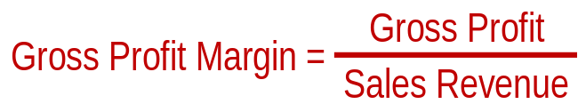
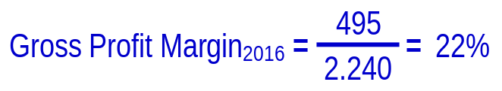
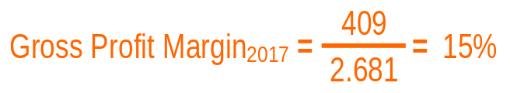
NTE 1010 – Introduction to Finance for Engineers
Financial Ratios – Profitability
Gross Profit Margin
  Relates Gross Profit for the period
  to the Sales Revenue during that period.
  It is a measure of profitability
  in buying (or producing) and selling goods
  before any other expenses are taken into account.
  The decline in this ratio could mean that
  sales prices were lower and/or
  the purchase cost of goods sold increased.
  It is possible that both were reduced,
  but sales prices at a greater rate.
  Or, both incresed,
  but cost of goods sold at a greater rate.
  Further analysis is needed
  to discover the causes.

Slide 11
Efficiency

Slide 12
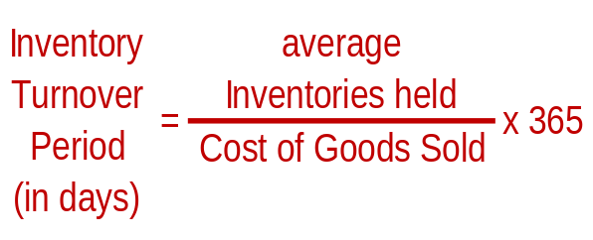
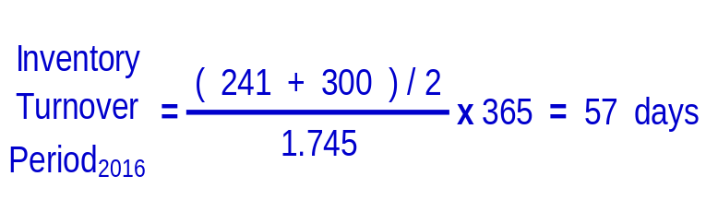
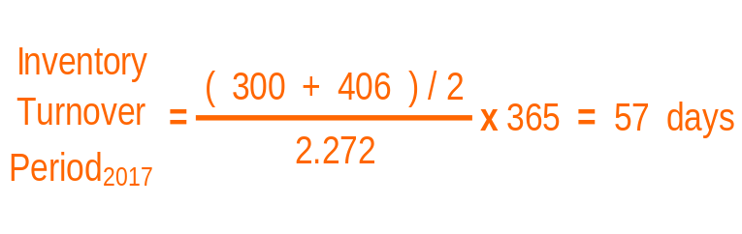
NTE 1010 – Introduction to Finance for Engineers
Financial Ratios – Efficiency
Average Inventories Turnover Period
  Inventories often represent a significant investment for a business.
  This ratio measures the average period (in days) for which the inventories are being held.
  In other words, it measures ″how fast″ the inventories are being sold (″turned over″).
  In case of a highly seasonal business, where inventory levels may vary considerably over the year, a monthly average may be more appropriate.

Slide 13
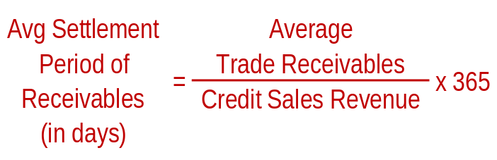
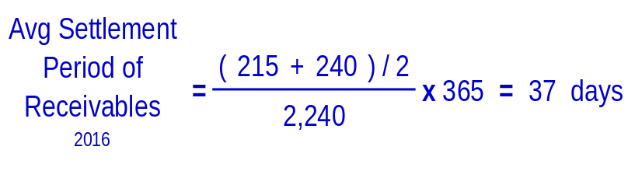
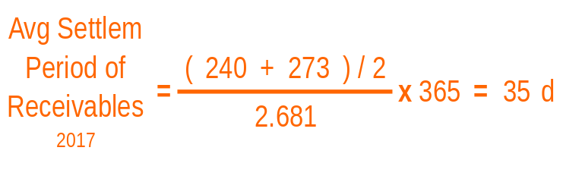
NTE 1010 – Introduction to Finance for Engineers
Financial Ratios – Efficiency
Avg Settlement Period for Receivables
  Speed of payment by customers can have a significant effect on business’ cash flow.
  This ratio measures the average period (in days) credit customers to pay
  the amounts that they owe to the business.
  On 1-1-2016, Trade Receivables was $215m.
  When opening balances are available, averaging Trade Receivables should be preferred.

Slide 14
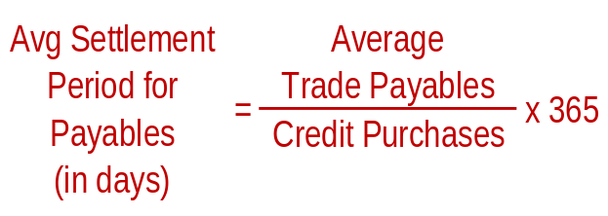
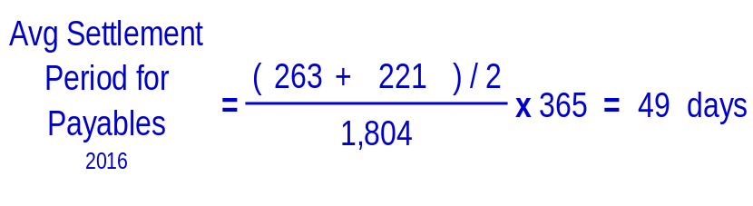
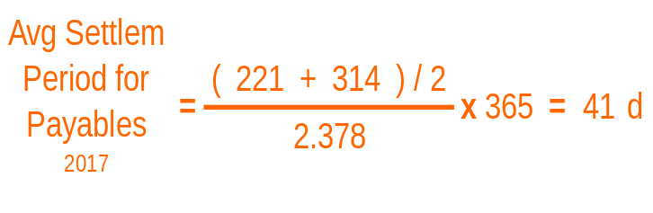
NTE 1010 – Introduction to Finance for Engineers
Financial Ratios – Efficiency
Avg Settlement Period for Payables
  Measures how long, on the average,
  the business takes to pay its trade payables.
  As trade payables provide a free source of finance for the business, most businesses attempt to increase their average settlement period. However, such a policy, if taken too far, would result in a loss of goodwill of suppliers.
  On 1-1-2016, Trade Payables was $263m.

Slide 15
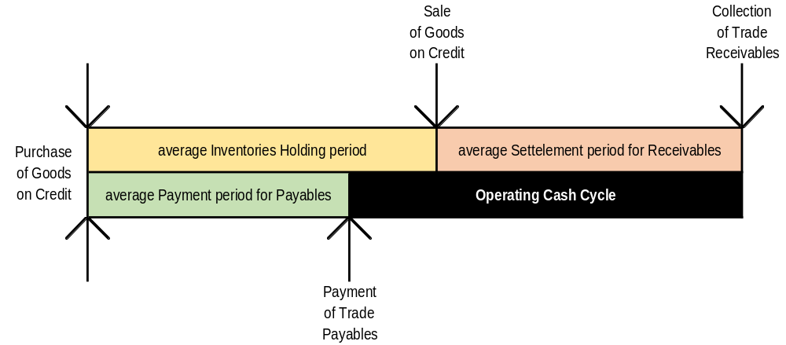
NTE 1010 – Introduction to Finance for Engineers
Financial Ratios - Efficiency
Operating Cash Cycle

Slide 16
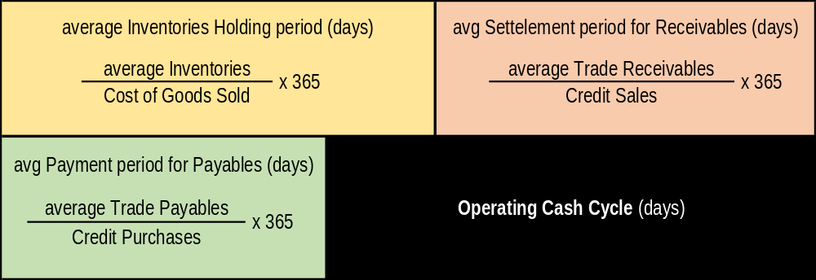
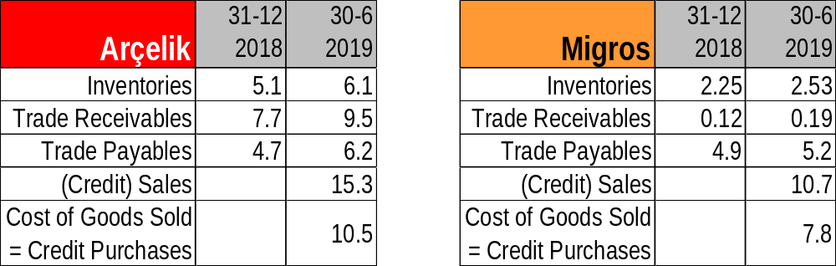
NTE 1010 – Introduction to Finance for Engineers
Financial Ratios - Efficiency
Measuring Operating Cash Cycle

Slide 17
Liquidity

Slide 18



NTE 1010 – Introduction to Finance for Engineers
Financial Ratios – Liquidity
Current Ratio
  Compares the ″liquid″ assets
  (cash and assets to be turned into cash soon)
  of the business with the current liabilities.
  There is no ″ideal″ Curent Ratio as diiferent types of business require different current ratios.
  As liquidity is vital to the survival of a business,
  a higher current ratio is preferable.
  Though there is a decline from 2016 to 2017,
  it is not necessarily a matter of concern.
  The next ratio may provide a clue
  as to whether there seems to be a problem.

Slide 19
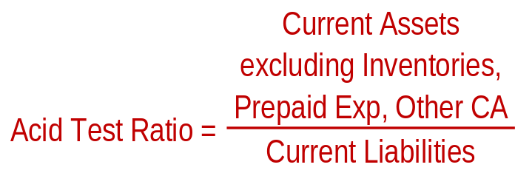
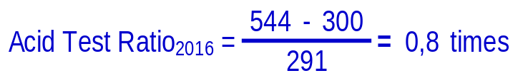

NTE 1010 – Introduction to Finance for Engineers
Financial Ratios – Liquidity
Acit Test Ratio
  Very similar to the Current Ratio,
  but it represents a more stringent test of liquidity.
  It excludes inventories,
  as it can be argued that, for many businesses,
  inventories cannot be converted into cash quickly.
  We can see now that the ″liquid″ Current Assets
  do not quite cover the current liabilities,
  so the business may be experiencing
  some liquidity problems.

Slide 20
Leverage

Slide 21
NTE 1010 – Introduction to Finance for Engineers
Financial Ratios
Financial Leverage
  Occurs when a business is financed, at least in part, by borrowing,
  instead of by finance provided by the owners (the shareholders).
  Level of leverage of a business is an important factor in assessing its risk.
  Where a business borrows, it takes on a commitment
  to pay interest charges and make capital repayments.
  Where the borrowing is heavy, this can be a significant financial burden;
  it can increase the risk of the business becoming insolvent.
  Nevertheless, most businesses are leveraged to some extent.
  This may be so, because the owners do not sufficient funds,
  so the only way to finance the business adequately is to borrow from others.
  Another reason is that leveraging can be used to increase the returns to owners.
  This is possible provided the returns generated from borrowed funds
  exceed the cost of paying interest.

Slide 22
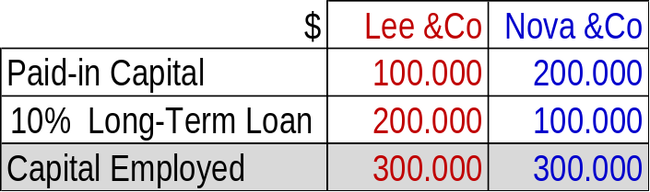
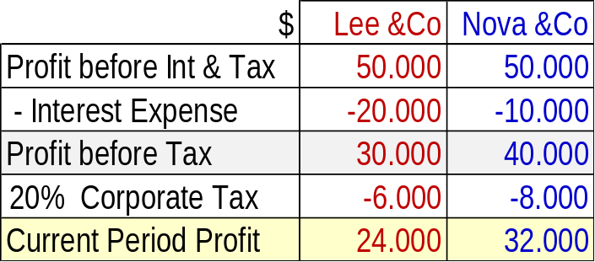
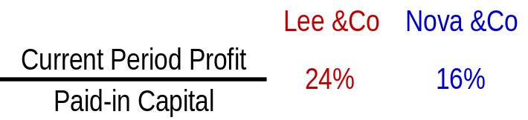
NTE 1010 – Introduction to Finance for Engineers
Financial Ratios
Financial Leverage

Slide 23
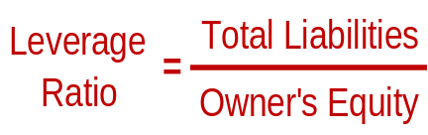
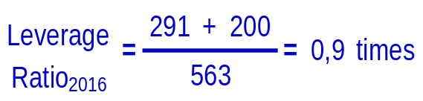
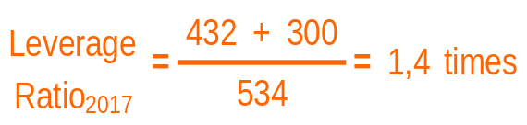
NTE 1010 – Introduction to Finance for Engineers
Financial Ratios – Leverage
Leverage Ratio
  Measures debt level of a company
  relative to its owner’s equity.

Slide 24
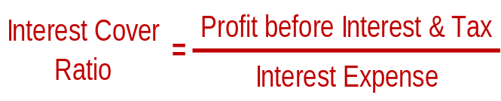
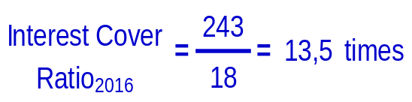
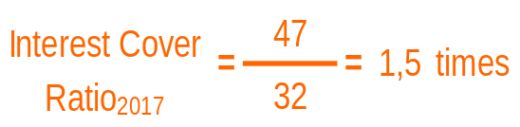
NTE 1010 – Introduction to Finance for Engineers
Financial Ratios – Leverage
Interest Cover Ratio
  Measures the amount of profit available
  to cover interest payable.

Slide 25
Investment

Slide 26
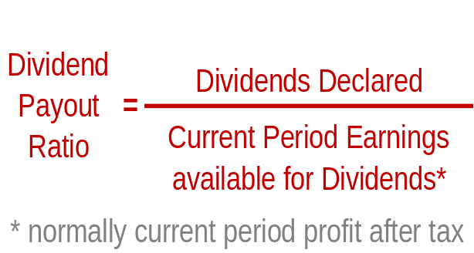
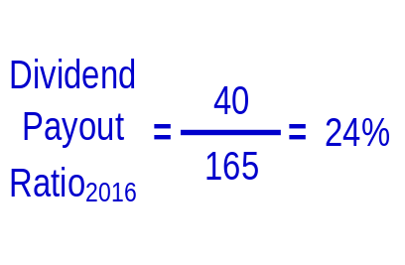
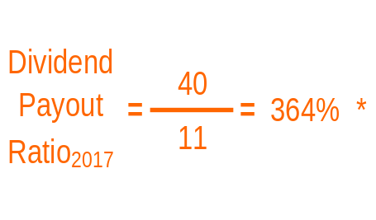
NTE 1010 – Introduction to Finance for Engineers
Financial Ratios – Investment
Dividend Payout Ratio
  Measures the proportion of earnings
  that a business pays out to shareholders
  in the form of dividends.
  * dividends to be paid
  out of earnings of previous years
  (i.e. Retained Earnings)

Slide 27
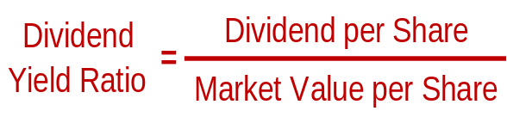
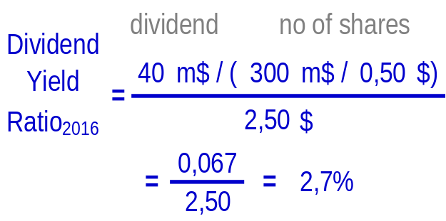
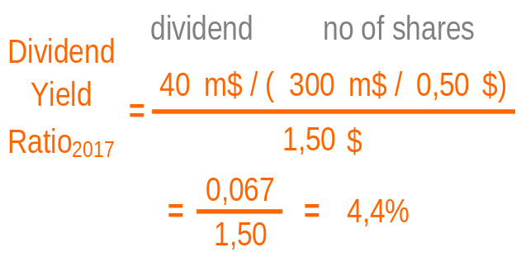
NTE 1010 – Introduction to Finance for Engineers
Financial Ratios – Investment
Dividend Yield Ratio
  Relates the cash return from a share
  to its current market value.

Slide 28
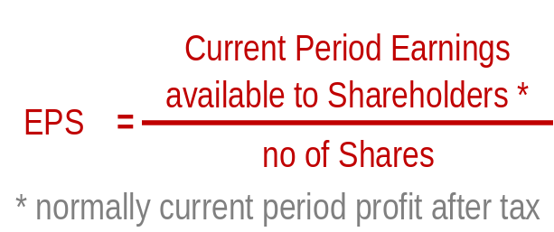
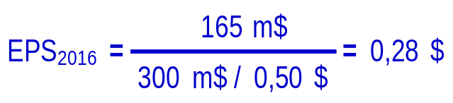
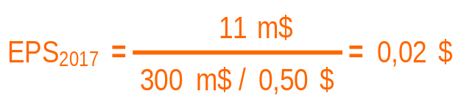
NTE 1010 – Introduction to Finance for Engineers
Financial Ratios – Investment
Earnings per Share (EPS)
  Relates the earnings generated by the business,
  and available to shareholders, during a period
  to the number of shares in issue.
  Many investment analysts regard the EPS ratio as a fundamental measure of share performance.
  Though it is possible to make total profits rise
  through shareholders investing more in the business, this will not necessarily result in profitability per share rising.

Slide 29
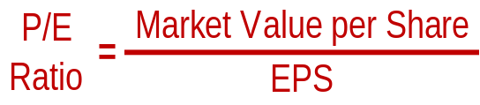
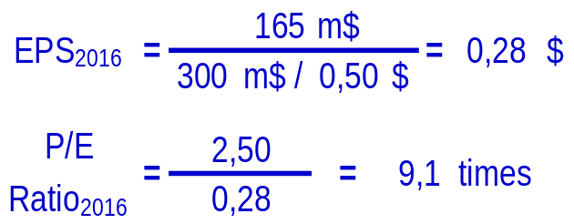
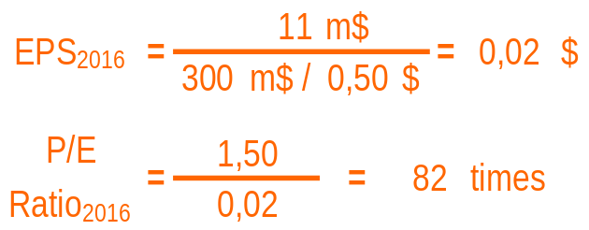
NTE 1010 – Introduction to Finance for Engineers
Financial Ratios – Investment
Price/Earnings Ratio (P/E)
  Relates market value of a share
  to the earnings per share.
  This ratio is a measure of market confidence
  in the future of a business.

Slide 30
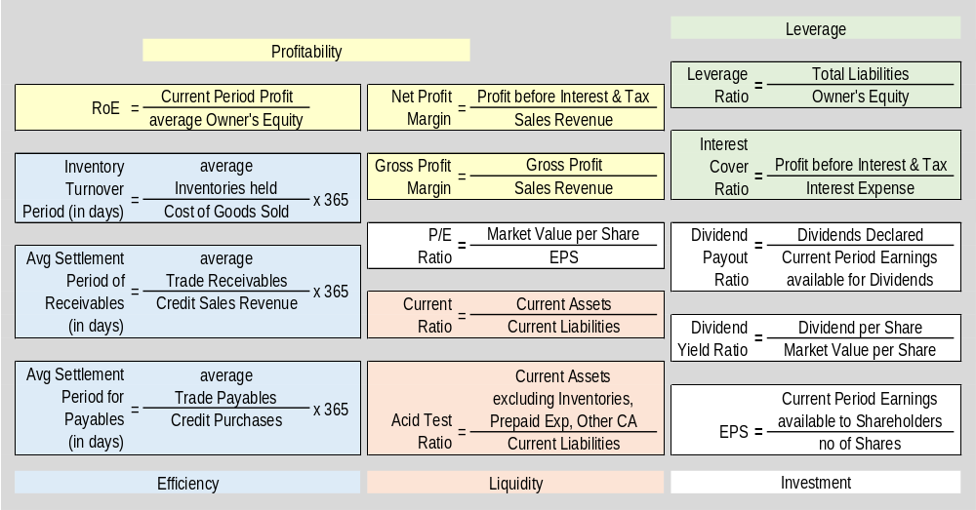
NTE 1010 – Introduction to Finance for Engineers
Financial Ratios
Summary of Major Ratios

Slide 31
NTE 1010
Introduction to Finance for Engineers
Spring 2020
Week 3
Analysing & Interpreting
Financial Statements
Ratio Analysis
Vertical & Horizontal Analysis

Slide 32
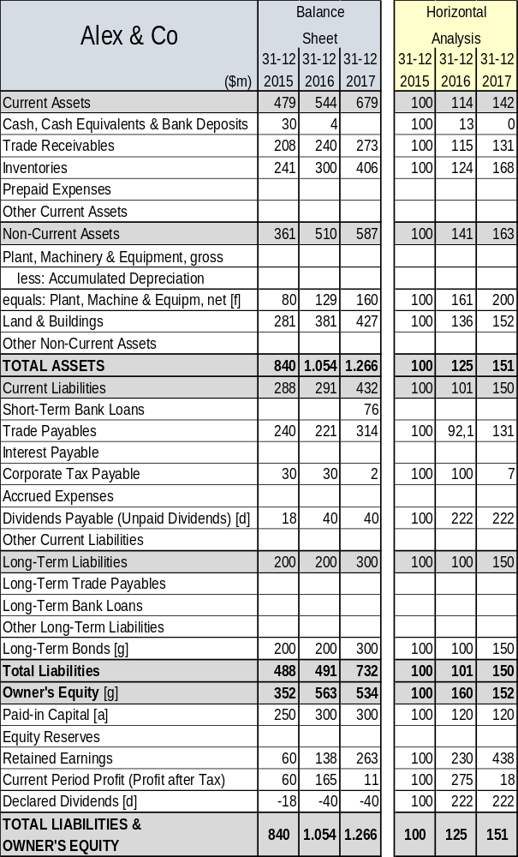
NTE 1010 – Introduction to Finance for Engineers
Financial Ratios
Horizontal Analysis

Slide 33
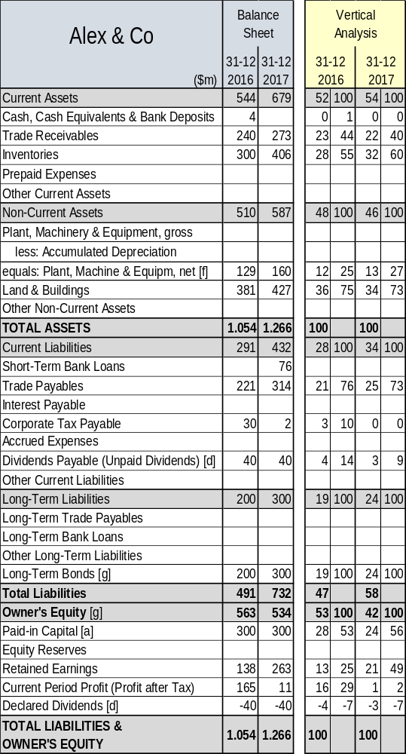
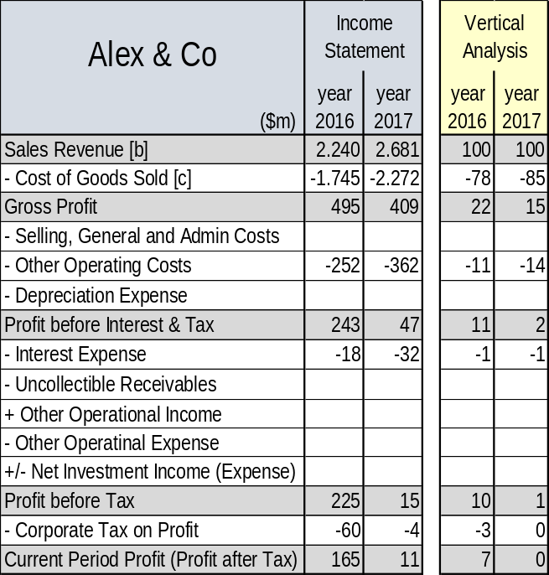
NTE 1010 – Introduction to Finance for Engineers
Financial Ratios
Vertical Analysis

Slide 34
NTE 1010
Introduction to Finance for Engineers
Spring 2020
Week 3
Analysing & Interpreting
Financial Statements
Ratio Analysis
Vertical & Horizontal Analysis
Ratio Analysis
exercise

Slide 35
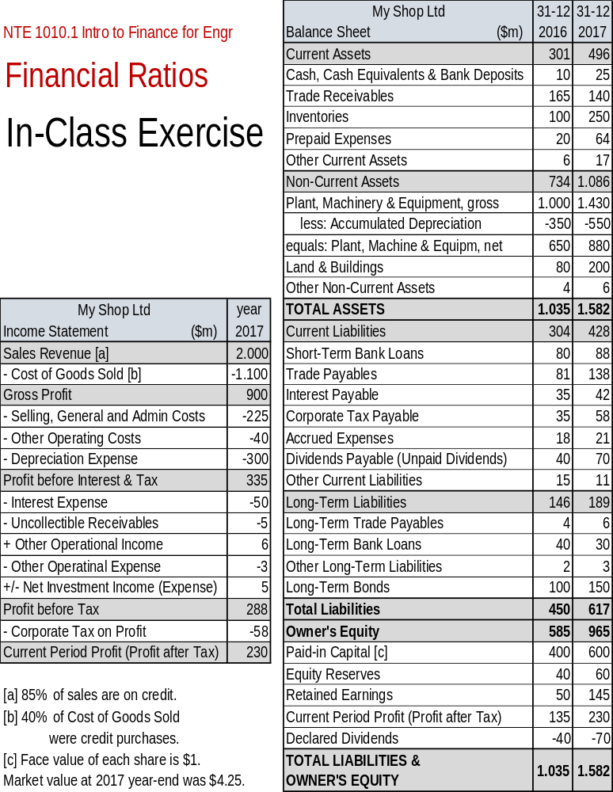



Slide 36



Slide 37



Slide 38



Slide 39



Slide 40




